Slide 1
Cross-Platform Magic: Transforming WPF Apps with Avalonia
Mike James

Slide 2
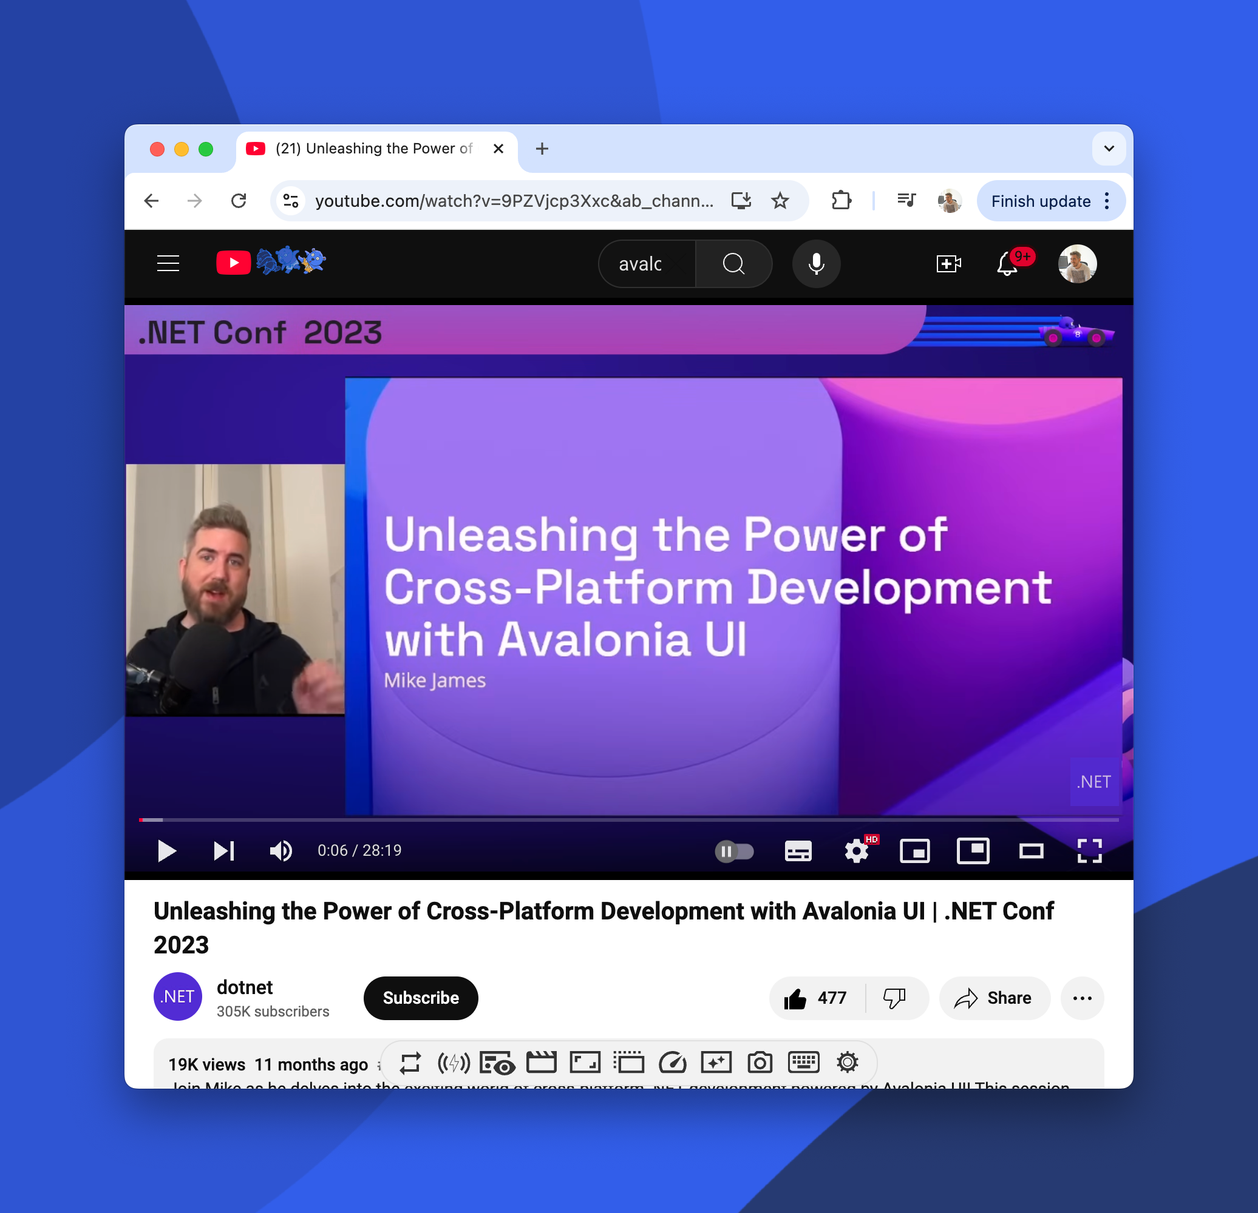

Watch Last Years Video
If you want a basic introduction to Avalonia and Avalonia XPF
then check out last years
https://tinyurl.com/5x7b38un

Slide 3
That’s enough slides
Let’s get started!

Slide 4
Resources
https://avaloniaui.net/
https://github.com/AvaloniaUI/Avalonia
Our Website
Our GitHub
https://docs.avaloniaui.net/
https://github.com/AvaloniaUI/Avalonia-XPF-Samples
Avalonia Documentation
XPF Samples
https://avaloniaui.net/xpf
avaloniaui.net/xpf
XPF Landing page
X Profile
https://www.reddit.com/r/avaloniaui/
https://www.linkedin.com/company/avaloniaui
SubReddit
LinedIn

Slide 5
Thank you

